Slide 1

Managing Microsoft Azure Stack Hub
Patching the Microsoft Azure Stack Hub Infrastructure
This work is licensed under a Creative Commons Attribution - ShareAlike 4.0 International Public License

Slide 2
Agenda
Overview
Servicing Policy
Update Packages
Update Flow
Administrative Tasks
Troubleshooting

Slide 3
Overview

Slide 4
Problem space
How can I avoid disruptions to my business/SLAs?
What updates do I install and what is the right order?
What tool(s) should I use?
Who do I call if there is an issue?
How often will updates be released?
What about security updates?
How do I know when updates are available and what has been tested or validated?
What about updates for my firmware and or drivers?
How can I generate compliance reports?
How do I know updates were actually applied to the correct endpoints?
How long should my maintenance windows be set?

Slide 5
Microsoft’s patch and update philosophy
Provide the ability to update the infrastructure while ensuring business applications, services, and workloads remain highly available (minimally disruptive)
Allow providers to focus on other aspects of the business
Provide an easy, safe, single-sourced update function released on a predictable cadence
Updates can and will range in scope from software to hardware – across all core components of the system
Provide predictability to better align with existing maintenance processes
Software updates are not applied to individual fabric VMs – a whole new (already patched) VM is swapped in, using clustering to maintain availability during the process

Slide 6
Servicing Policy

Slide 7
Servicing Policy
To receive support for your system, you must keep your Azure Stack Hub updated within a specific interval. The Azure Stack Hub Servicing policy allows a deferral of Microsoft software updates for up to three releases.
If your system is more than three releases behind, you’re considered out of compliance. You must update the system to at least the minimum supported version to receive support.
1805
1807
1808
1809
out-of-support
min supp. Version
latest release

Slide 8
Servicing Policy
The following table shows example update package releases, their prerequisite, and the minimum supported version that your system must be at to maintain support.
Microsoft software update packages are non-cumulative and require the previous update package as a prerequisite. If you decide to defer one or more updates, consider the overall runtime if you want to get to the latest version.
Latest Update Package (example) | Prerequisite | Minimum Supported Version
2008 | 2005 | 2002
2005 | 2002 | 1910
2002 | 1910 | 1908
1910 | 1908 | 1907
1908 | 1907 | 1906
1907 | 1906 | 1905

Slide 9

Update Packages

Slide 10
Package types
There are two types of update packages for Azure Stack Hub integrated systems:
Microsoft software updates
Deployed using the Azure Stack Hub administrator portal
Includes Windows Server security updates, non-security updates, and Azure Stack Hub feature updates
OEM hardware vendor-provided updates, such as drivers and firmware
Deployed using the Azure Stack Hub administrator portal
Some hardware vendors may require a hardware vendor VM that handles the internal firmware update process
Hosted on their own download site and have their own release cycle
Check with your OEM about their specific process
Source: Azure Stack Hub servicing policy https://docs.microsoft.com/en-us/azure/azure-stack/azure-stack-servicing-policy#update-package-types

Slide 11
Microsoft software updates
Full | Express | Hotfixes
Full update packages update the physical host operating systems in the scale unit and require a larger maintenance window | Express update packages are scoped and don't update the underlying physical host operating systems, so require a smaller maintenance window | Hotfixes address a specific issue that's often preventive or time-sensitive. Unlike a full or express update, hotfixes can install in minutes.
Microsoft Updates
Microsoft releases multiple full and express software update packages per year for Azure Stack Hub integrated systems on a regular cadence that will typically fall on the fourth Tuesday of a month. Some months may not have an update.

Slide 12
Package versioning
Microsoft update packages have the following naming convention to easily identify the release date:
MajorProductVersion.YYMM.MinorVersion.BuildNumber
For example, the August 2020 release is 1.2008.13.88
A hotfix for 2008 increments the minor version and build number, e.g., 1.2008.20.102
See http://aka.ms/azurestackupdate for details.
Year
20
08
Month

Slide 13
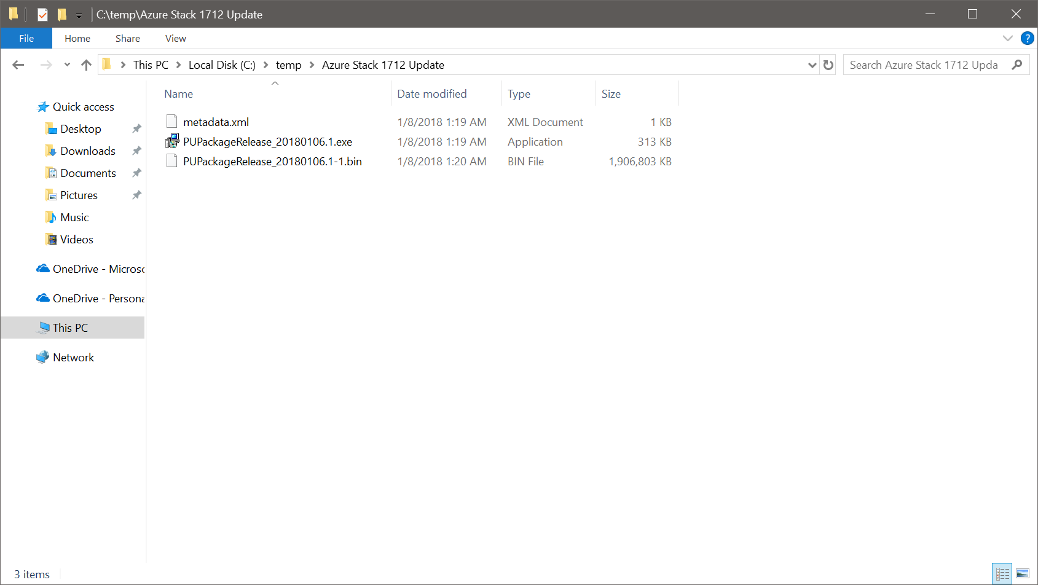
Package contents (1 of 2)
An update package typically consists of the following files:
A self-extracting PackageName.exe file. This file contains the payload for the update, for example the latest cumulative update for Windows Server.
Corresponding PackageName.bin files. These files provide compression for the payload that's associated with the PackageName.exe file.
A Metadata.xml file. This file contains essential information about the update, for example the publisher, name, prerequisite, size, and support path URL.

Slide 14
Package contents (2 of 2)
The metadata.xml contains relevant metadata for the update like Size, Name, MinVersion, Description etc:
</UpdatePackageManifest><UpdateName>AzS Update - 1.1809.0.90</UpdateName> <Version>1.1809.0.90</Version> <PackageSizeInMb>2379</PackageSizeInMb> <Description>AzS Update 1.1809.0.90</Description> <KBLink>https://aka.ms/azurestackupdate</KBLink> <MinVersionRequired> 1.1808.5.110 </MinVersionRequired>

Slide 15


Updates: How do we do it?
Customers
Window Server monthly KB
Developer
Build
Continuous integration & Validation
…….
Hardware partner labs
Deploy & validate
Hardware partner labs
100’s of multi-node systems
Hardware partner labs
…….
…….
…….
4 node system
Long haul/Self-host environments
Testing by each partner
…….
10’s of multi-node systems

Slide 16
Update Flow

Slide 17
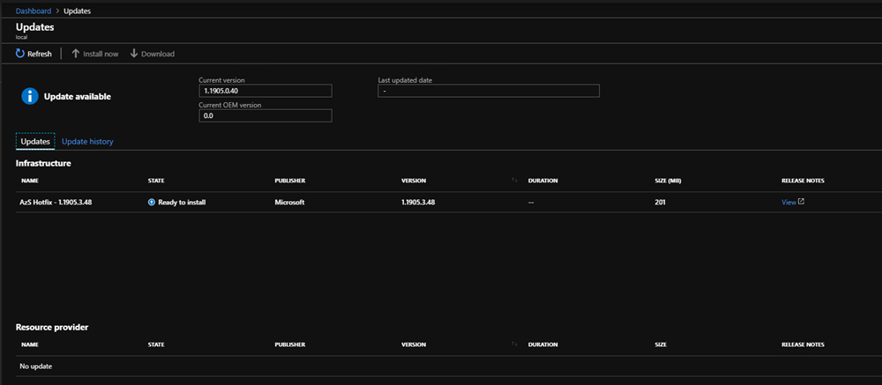
Available Updates – Phase 1
Connected Azure Stack Hub deployments show software updates and hotfixes automatically
Update is automatically downloaded and prepared when the update is applied

Slide 18
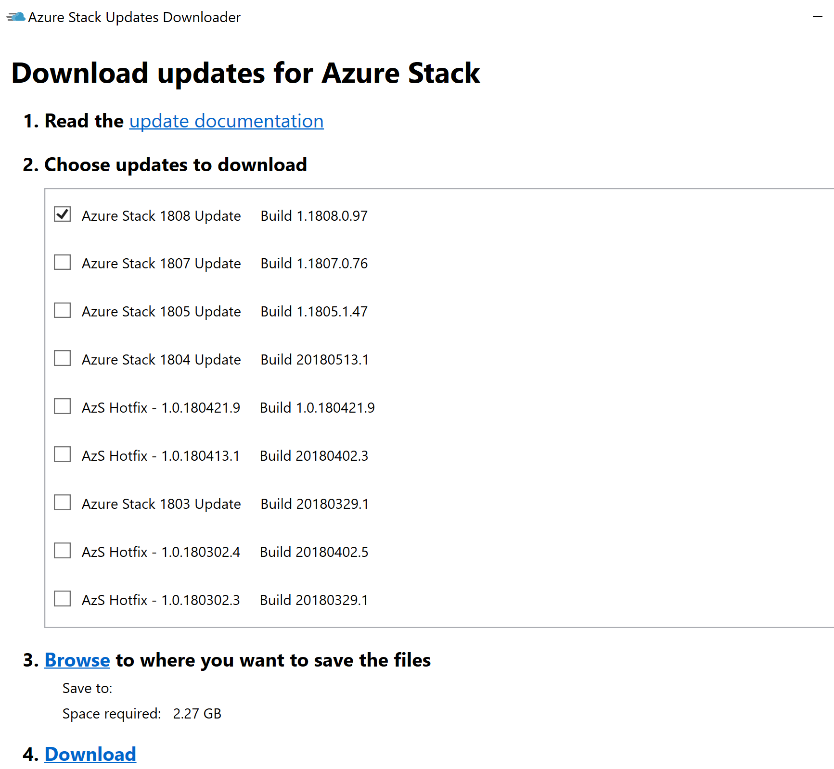
Preparing the update package (if necessary)
Required for disconnected or weak connection deployments + OEM package updates
Download from internet and upload to Azure Stack Hub
+
=
Azure Stack Hub Updates Downloader/ OEM website
OS + Azure Stack Hub updates
Host OS stored on
\\infrastructure_share
New Host OS Image + Azure Stack Hub SW
Azure Stack Hub

Slide 19

Azure Stack Hub Updates – Phase 2
Min available capacity: Approximately one server
Each host server is evacuated and a fresh OS image is applied
Apply config
Boot from
Server 1
Server 2
Server 3
Server 4
VHD
(Host OS)
New VHD
(Host OS)
VHD
(Host OS)
New VHD
(Host OS)
VHD
(Host OS)
New VHD
(Host OS)
VHD
(Host OS)
New VHD
(Host OS)
4 Node Azure Stack Hub

Slide 20
Azure Stack Hub Updates – Phase 3
Min available capacity: Approximately one server
Clustered fabric VMs have the cluster nodes replaced by fresh VMs one at a time
Apply image-based update to Azure Stack Hub Software
Boot from
Server 1
Server 2
Server 3
Server 4
New VHD
(Host OS)
New VHD
(Host OS)
New VHD
(Host OS)
New VHD
(Host OS)
4 Node Azure Stack Hub

Slide 21
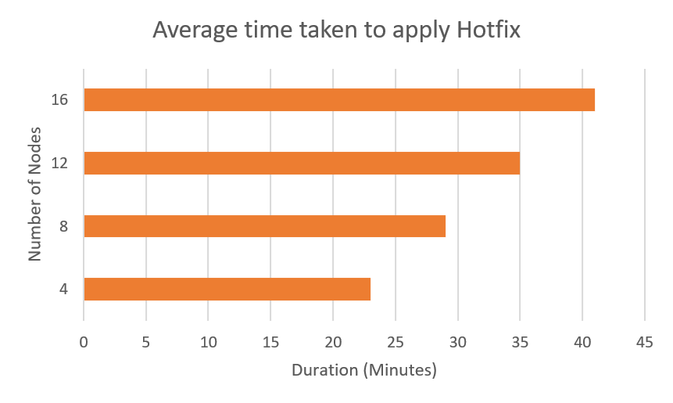
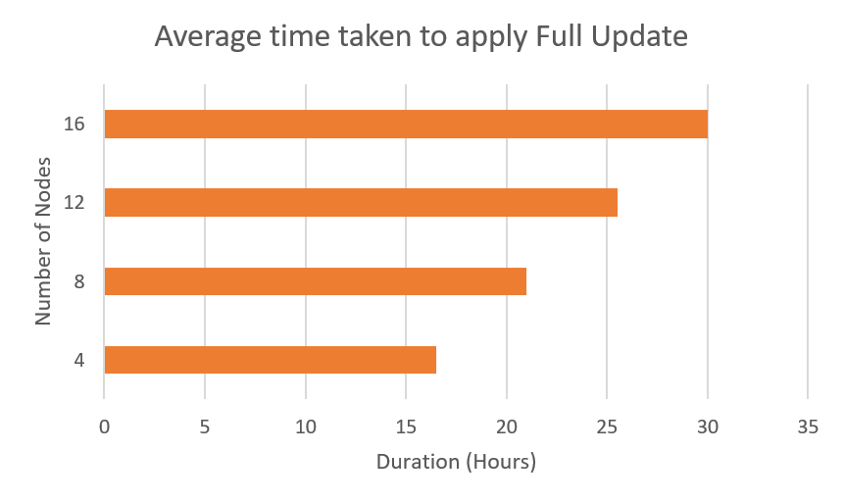
Example times for applying Microsoft updates
Goal: Limit workload impact during admin operations (patching, secret rotation)
Targeting availability offered by Azure
Times will vary depending upon workloads and the number of Azure Stack Hub nodes

Slide 22
Administrative Tasks

Slide 23
Download Microsoft update packages
Connected
Starting with Azure Stack Hub 1807 new updates and hotfixes automatically show up in the Administration Portal when they are available. There is no need to download them manually.
If necessary, it is still possible to download and upload them out of band.
Disconnected
In disconnected environments or environments with a weak internet connection, updates can be downloaded externally and uploaded to Azure Stack Hub.

Slide 24
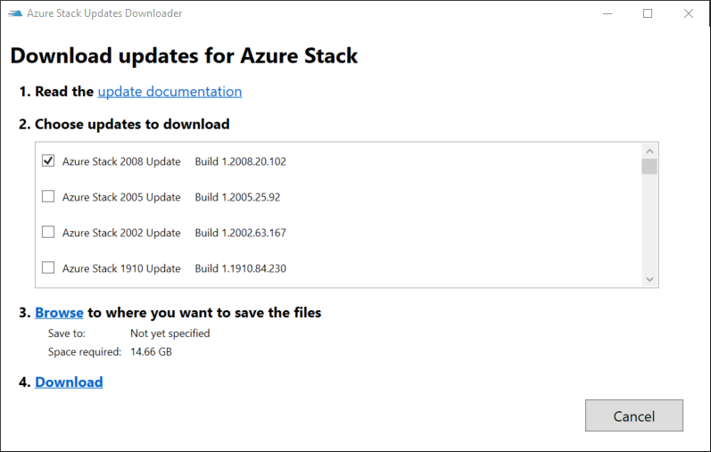
Download update packages
Disconnected / Out-of-band
For environments without Internet or with a weak internet connection.
Azure Stack Hub Updates Downloader
https://aka.ms/azurestackupdatedownload
All update package related information is documented in the corresponding release notes
https://docs.microsoft.com/en-us/azure-stack/operator/release-notes

Slide 25
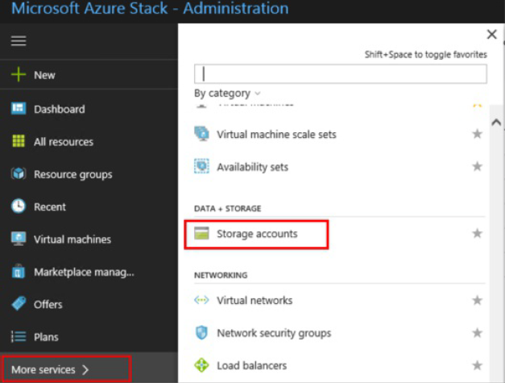
Upload update packages (1 of 6)
After downloading the Microsoft update package, you must upload the update package to your Azure Stack Hub Environment.
This is the same for OEM updates
In the administrator portal, select More services. Then, under the Data + Storage category, select Storage accounts. (Or, in the filter box, start typing storage accounts, and select it.)

Slide 26
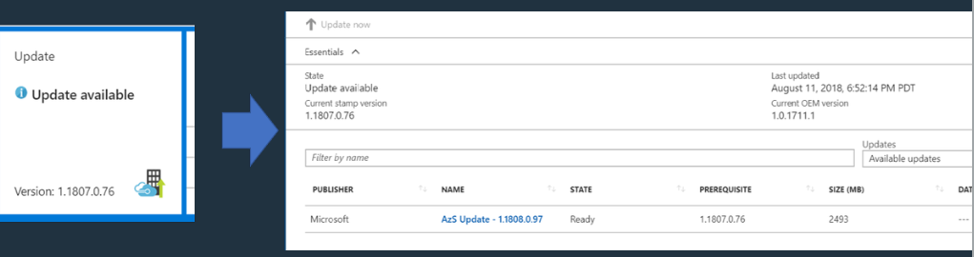
Updates are visible in the operator portal
Click on the update tile to see details of the update

Slide 27
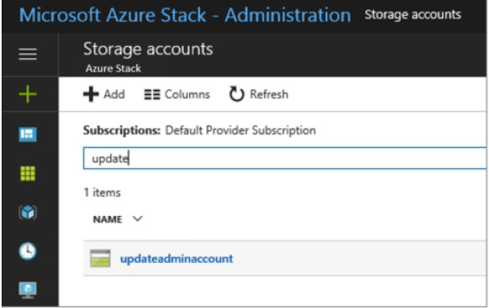
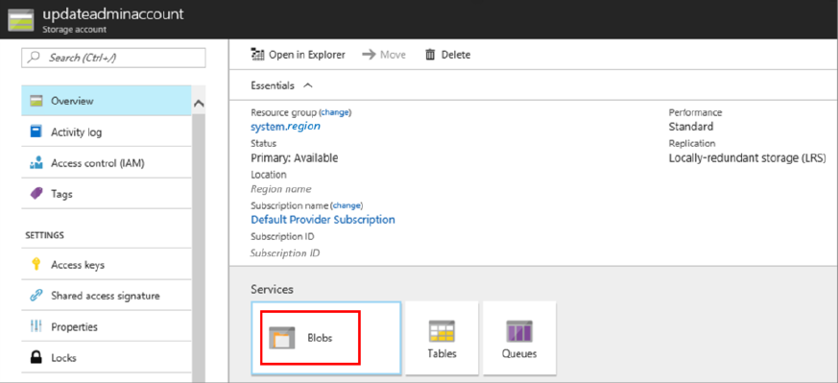
Upload update packages (2 of 5)
In the filter box, type update, and select the updateadminaccount storage account.
In the storage account details, under Services, select Blobs.

Slide 28
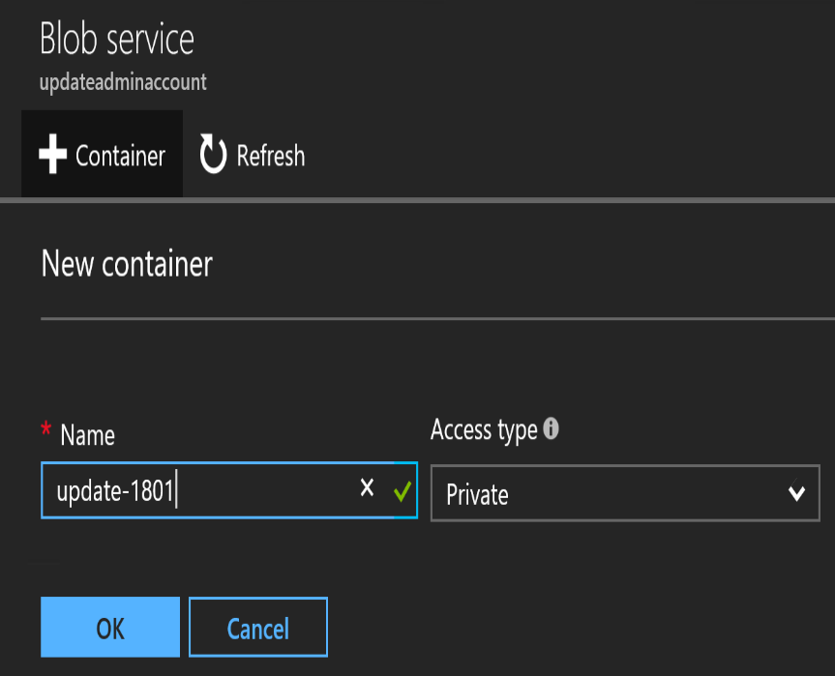
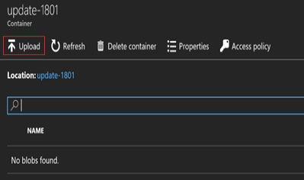
Upload update packages (3 of 5)
Under Blob service, select + Container to create a container. Enter a name (for example Update-1802), and then select OK.
After the container is created, click the container name, and then click Upload to upload the package files to the container.
Under Upload blob, click the folder icon, browse to the update package's .exe file, and then click Open in the file explorer window.

Slide 29
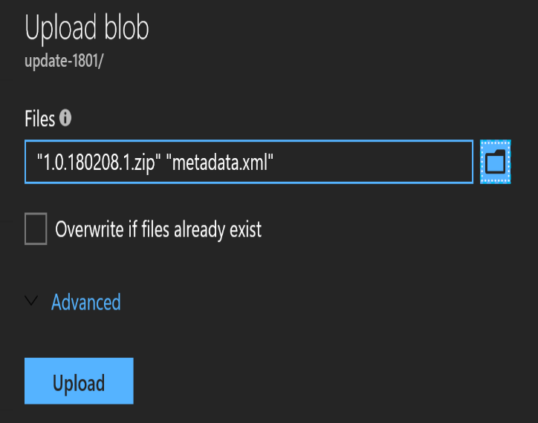
Upload update packages (4 of 5)
Under Upload blob, click Upload.
Repeat steps 6 and 7 for the PackageName.bin and Metadata.xml files. Or select multiple files at once.
When done, you can review the notifications (bell icon in the top-right corner of the portal). The notifications should indicate that the upload has completed.

Slide 30
Upload update packages (5 of 5)
Navigate back to the Update tile on the dashboard. The tile should indicate that an update is available. Click the tile to review the newly added update package.
To install the update, select the package that's marked as Ready and either right-click the package and select Update now, or click the Update now action near the top.
When you click the installing update package, you can view the status in the Update run details area. From here, you can also click Download full logs to download the log files.
When the update completes, the Update tile shows the updated Azure Stack Hub version.

Slide 31
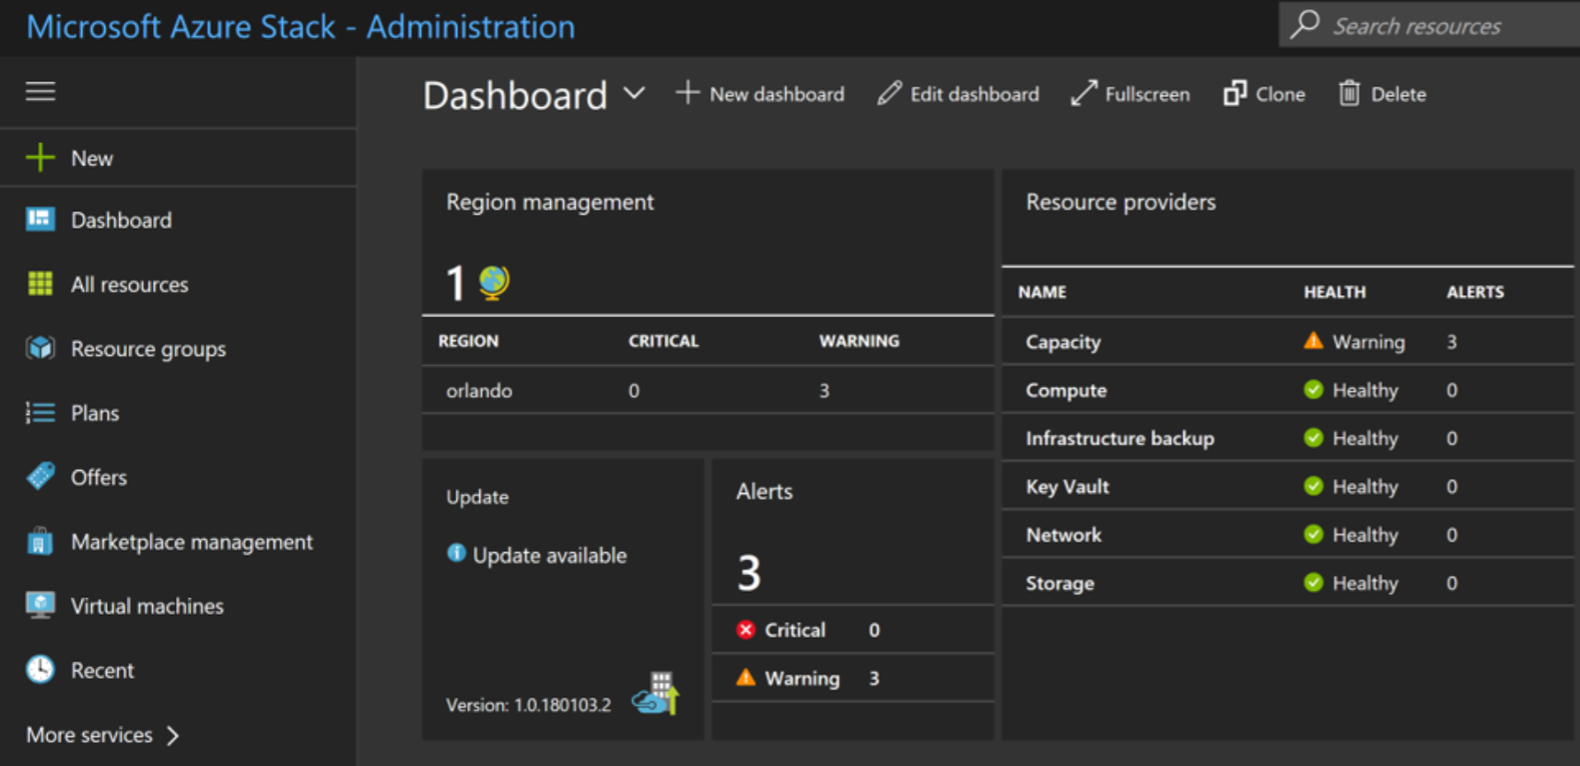
Start updates (using the Portal)
new update available

Slide 32
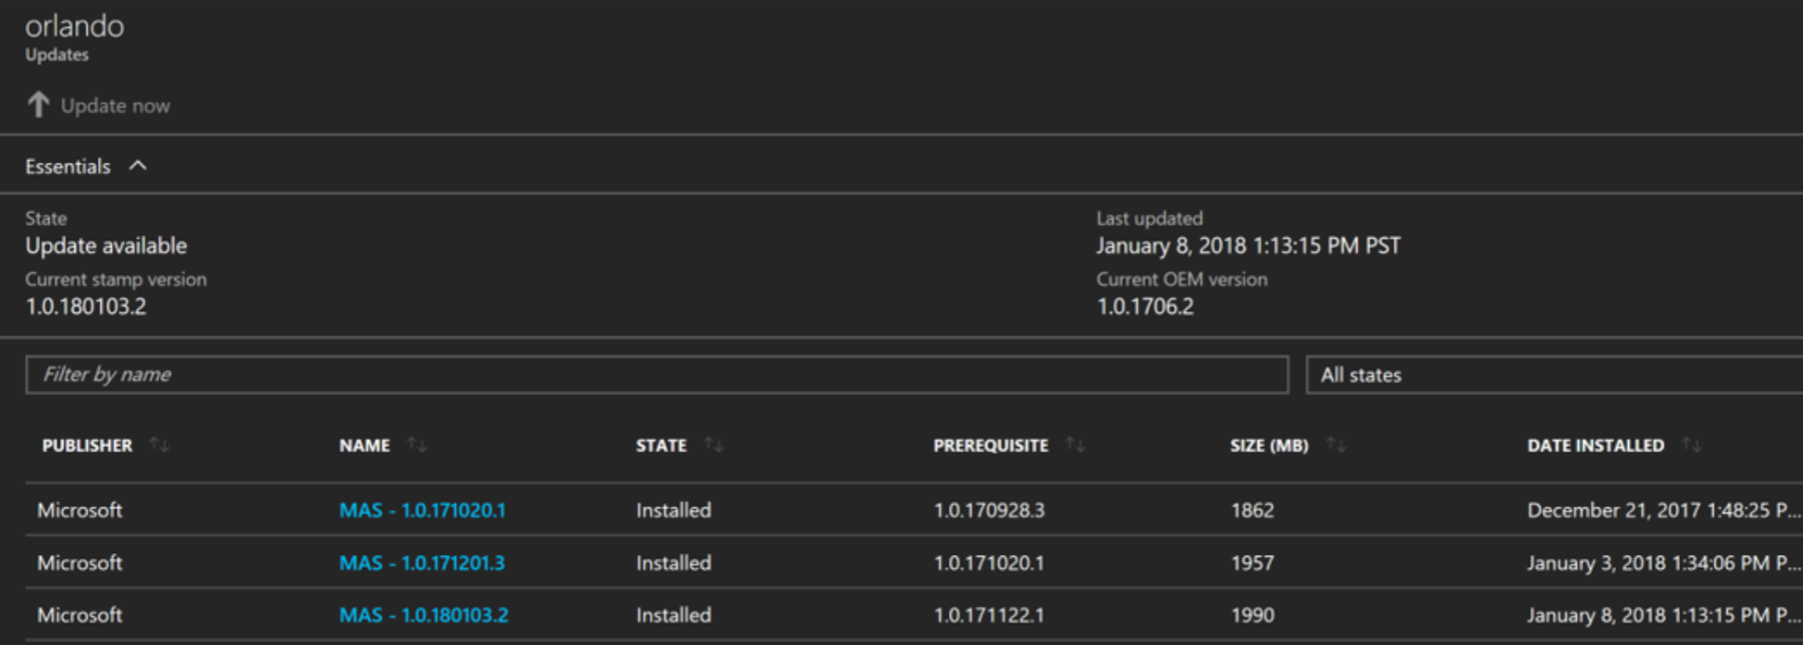
Start updates (using the Portal)
Click Update now to start
Installed and available updates

Slide 33
Start updates (using PowerShell)
Requires AzureStack-Tools
Useful PowerShell cmdlets for starting and monitoring the status of updates:
Get-AzsUpdateLocation
Retrieves region update summary
Get-AzsUpdate
Lists Azure Stack Hub updates
Install-AzsUpdate -Update “Update Version”
Applies specified update, e.g. Install-AzsUpdate -Update Microsoft1.1907.0.10
Get-AzsUpdateRun
Retrieves the progress and status for a specific Azure Stack Hub update

Slide 34
Monitor updates
You can use the privileged endpoint (PEP) to monitor the progress of an Azure Stack Hub update run, and to resume a failed update run from the last successful step should the Azure Stack Hub portal become unavailable.
Using the Azure Stack Hub portal is the recommended method to manage updates.
The Get-AzureStackUpdateStatus cmdlet returns the status of the currently running, completed, or failed update. It provides the high-level status of the update operation and an XML document that describes both the current step and the corresponding state:
$pepSession = New-PSSession -ComputerName Azs-ERCS01 ` -ConfigurationName PrivilegedEndpoint ` -Credential (Get-Credential)
Invoke-Command -Session $pepSession -ScriptBlock { Get-AzureStackUpdateStatus }

Slide 35
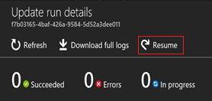
Resume updates
If the update fails, it can be resumed from where it left off through the Portal or the Privileged Endpoint (PEP). In certain scenarios, you may have to complete mitigation steps before you resume the update.
Portal Navigate to the pane of the update run details Click Resume
PowerShell Command The Resume-AzureStackUpdate cmdlet resumes the current update installation from the point it failed. $pepSession = New-PSSession -ComputerName Azs-ERCS01 ` -ConfigurationName PrivilegedEndpoint ` -Credential (Get-Credential) Invoke-Command -Session $pepSession -ScriptBlock { Resume-AzureStackUpdate }

Slide 36
Azure Stack Hub Patch and Update Recap
Updates are released multiple times per year
Support policy: N – 2 (e.g. 2008, 2005, 2002)
Updates include Security payload, new capabilities, bug fixes
Updates are non-cumulative
Hotfixes are issued as needed and are cumulative
Firmware updates are applied in a separate pass
Year
20
08
Month

Slide 37
Troubleshooting

Slide 38
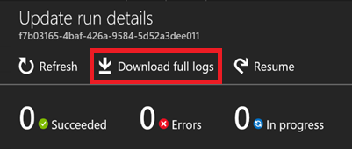
Analyze update logs (1 of 2)
Azure Stack Hub allows us to download the logfiles for all succeeded and failed updates per update run.
The logfile itself is a JSON File. To make this more readable use PowerShell:
$json = Get-Content C:\Updatelogs_4848628f-0f78-4b3f-9258-50728254a202.json | ConvertFrom-Json
# Get top-level steps
$json.properties.progress.steps.steps

Slide 39
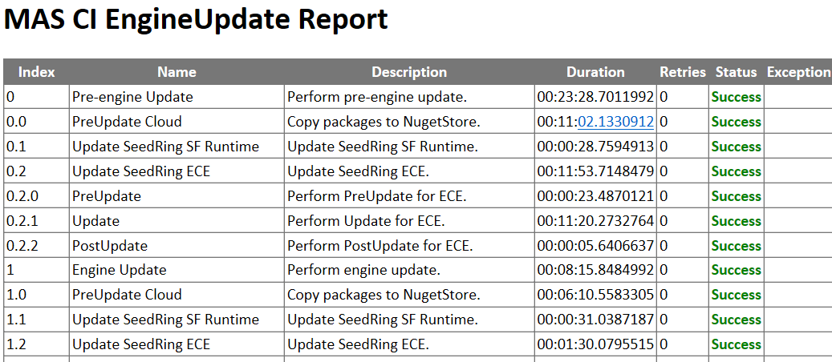
Analyze update logs (2 of 2)
Another option is to convert the JSON File into a HTML file for improved readability.

Slide 40
Additional Logs
To gather additional logs, you can use Get-AzureStackLog (for example from the Privileged Endpoint).
The example above will collect all Azure Stack Hub related Logfiles and write them onto a network share. The scope can be limited to URP (Update Resource Provider) logfiles only by using FilterByRole URP.
$pepSession = New-PSSession -ComputerName Azs-ERCS01 ` -ConfigurationName PrivilegedEndpoint ` -Credential (Get-Credential)
Invoke-Command -Session $pepSession -ScriptBlock {
Get-AzureStackLog -OutputDir \\accessible\path
}

Slide 41
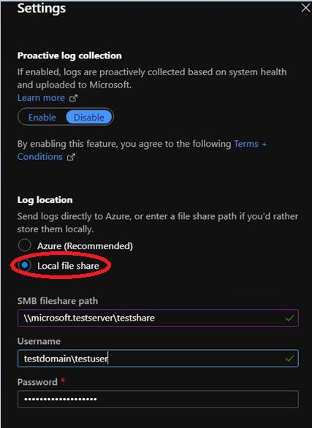
Additional Logs
To gather additional logs, you can use the Portal or Get-AzureStackLog from the Privileged Endpoint.
$pepSession = New-PSSession -ComputerName Azs-ERCS01 ` -ConfigurationName PrivilegedEndpoint ` -Credential (Get-Credential)
Invoke-Command -Session $pepSession -ScriptBlock {
Get-AzureStackLog -OutputDir \\accessible\path
}
The example above will collect all Azure Stack Hub related Logfiles and write them onto a network share. The scope can be limited to URP (Update Resource Provider) logfiles only by using FilterByRole URP.

Slide 42
Questions?

Slide 44
Azure Stack Hub tools (for update)
The Azure Stack Hub Infrastructure Administration module (part of the Azure Stack Hub Tools) give you some additional commands to manage Azure Stack Hub Updates through PowerShell.
Azure Stack Hub infrastructure administration https://github.com/Azure/AzureStack-Tools/tree/master/Infrastructure
Commandlet | Description
Get-AzsUpdateLocation | Review the Update Summary for a specified region.
Get-AzsUpdate | Retrieves list of Azure Stack Hub Updates
Install-AzsUpdate -Update "Update" | Applies a specific Azure Stack Hub Update that is downloaded and applicable. Run Get-AzureStackUpdate to retrieve Update Version first
Get-AzsUpdateRun -Update "Update" | Should be used to validate a specific Update Run or look at previous update runs

